Slide 1
SNe Ia - Reddening Estimates
Emma Irene Barile
Akum Gill
Peter Massey
Niccolò Passaleva
Hira Waseem
Advisor: Giorgio Valerin

Slide 2
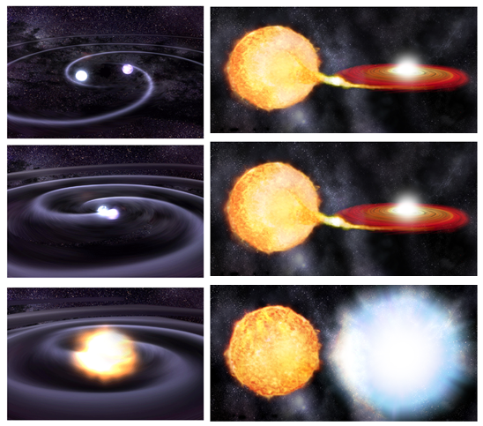
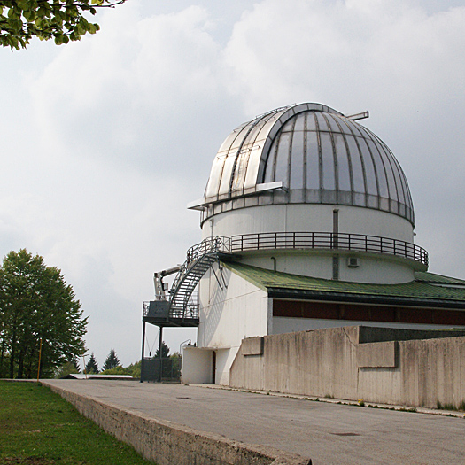
Introduction [1/8]: SNe Ia
Si S Ca Mg O C
⁵⁶Ni
↓
⁵⁶Co
↓
⁵⁶Fe
Wikipedia Commons

Slide 3
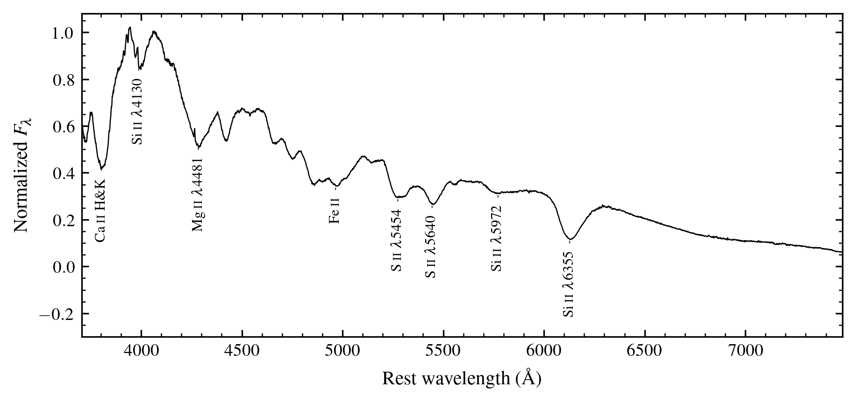
Introduction [2/8]: Ia Spectra

Slide 4
Introduction [3/8]: What else can Ia spectra probe?
Si, S, Ca, Mg, O, C
Dust and gas
Na
⁵⁶Ni
↓
⁵⁶Co
↓
⁵⁶Fe
Ia spectra can also probe the intervening material properties

Slide 5
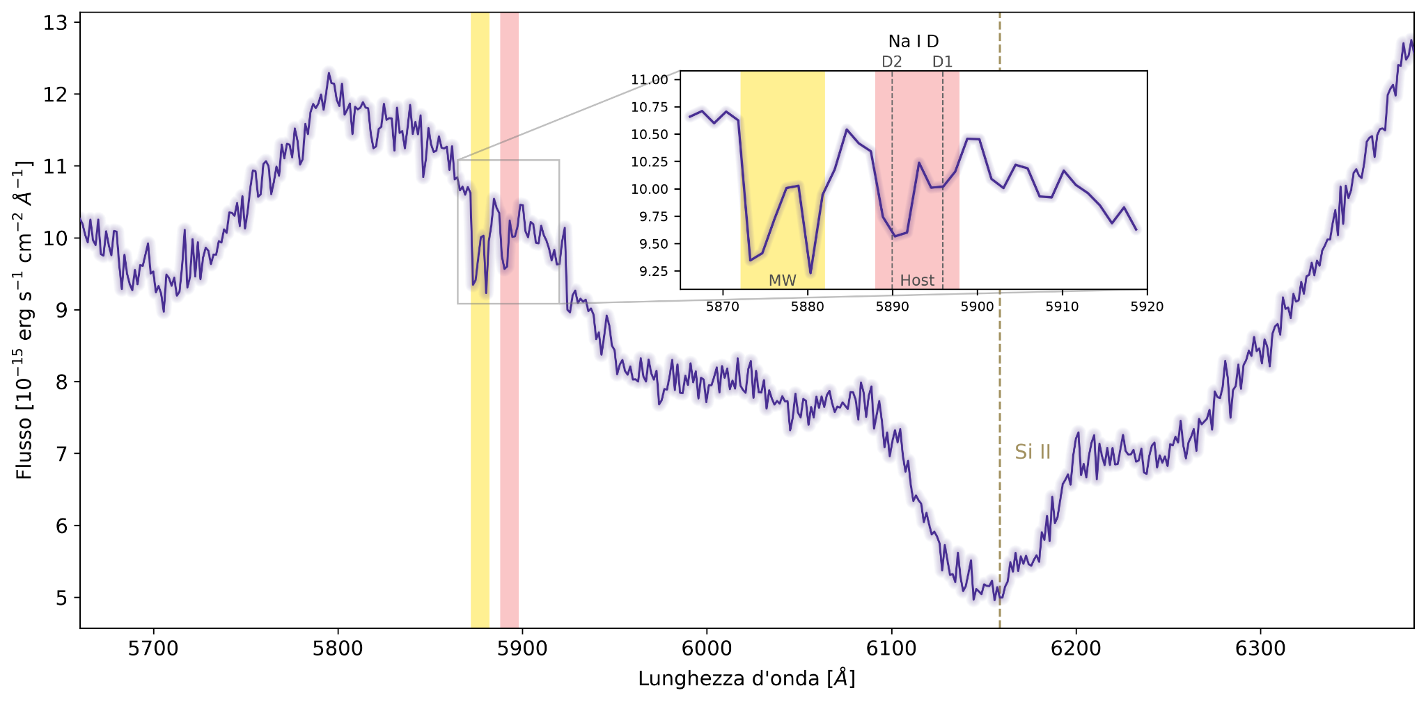
Introduction [4/8]: The Sodium I D lines

Slide 6
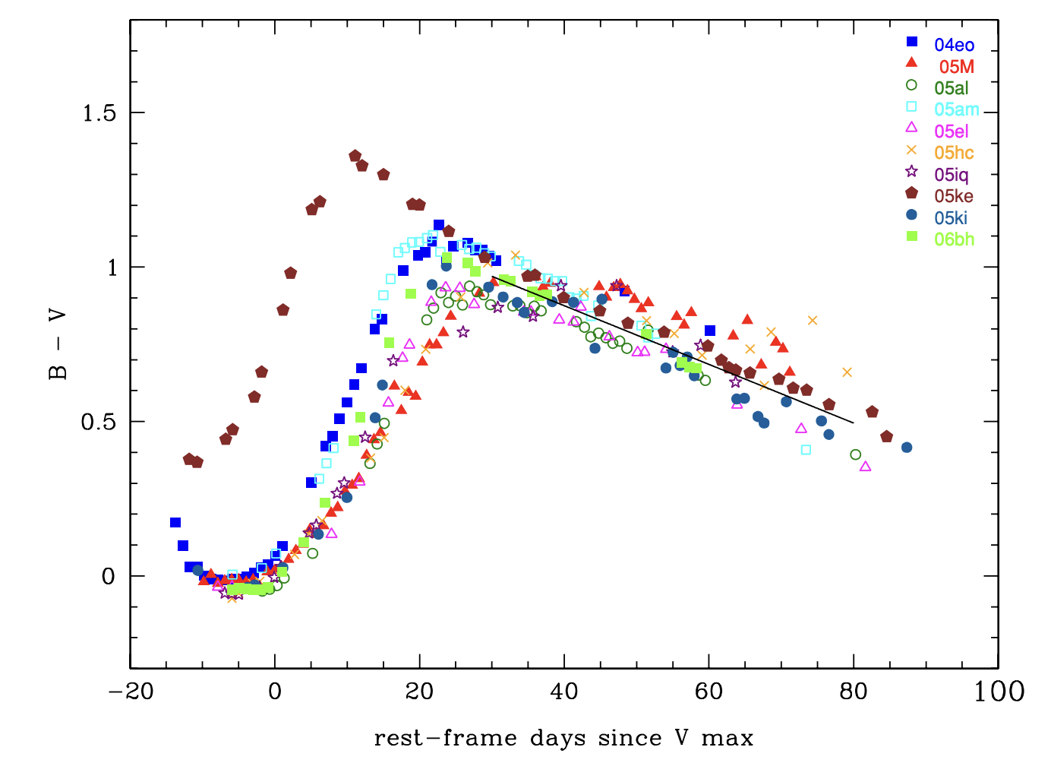
Introduction [5/8]: Lira Relation
B-V: how much more magnitude in the B-band (bluer light) than the V-band (redder light)
E(B-V): colour excess (compared to no extinction)
A_{V} : observed V-band magnitude - intrinsic V-band magnitude
R_{V} = A_{V} / E(B-V)

Slide 7
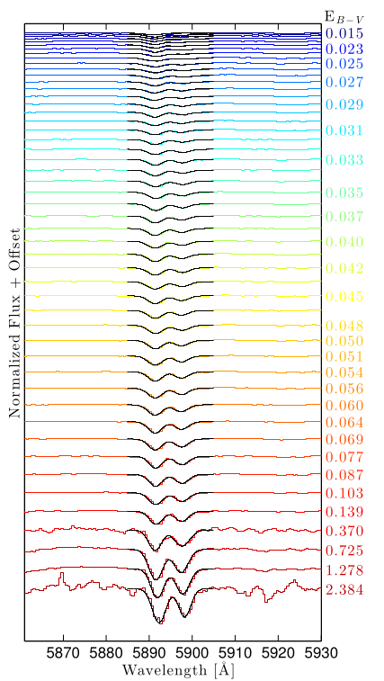
Introduction [6/8]: Na I D as an extinction tracer
Equivalent widths (EWs) of the individual components of Na I D correlate with extinction
Poznanski et al. (2012)
λ5890 (D2)
λ5896 (D1)

Slide 8
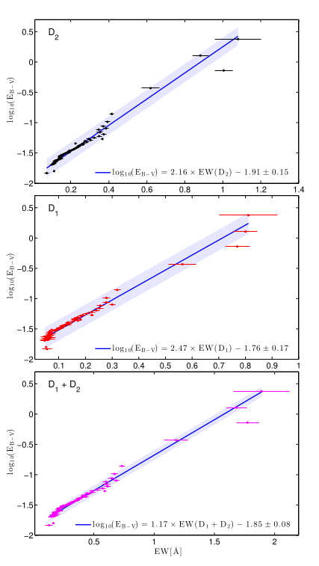
Introduction [7/8]: Na ID as an extinction tracer
Equivalent widths (EWs) of the individual components of Na I D correlate with extinction
Poznanski et al. (2012)
Logarithm of the color excess linear with respect to the equivalent widths
Here they used quasars and galaxies mainly from the Sloan Digital Sky Survey

Slide 9
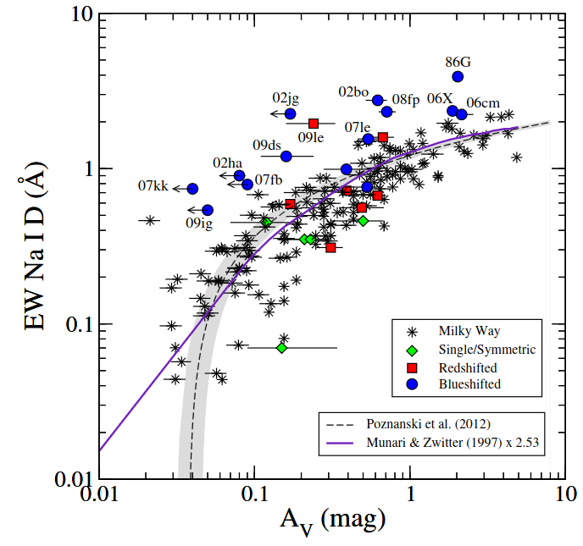
Introduction [8/8]: Na ID and SNe Ia
Attempt to apply the Poznanski relation to Type Ia SNe in Philips et al. (2013)
Many SNe show a higher Na I D EW than expected
These same SNe have “Blueshifted” Na I D absorption profiles
EW is not always completely reliable to trace extinction

Slide 10
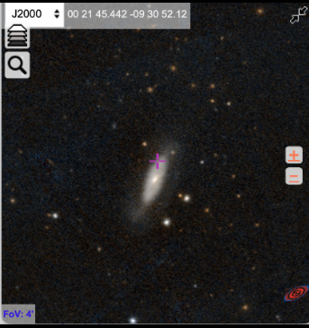
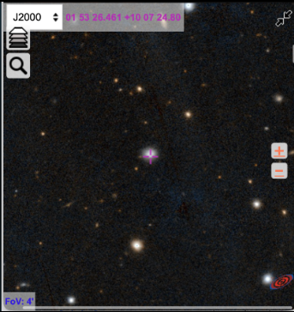
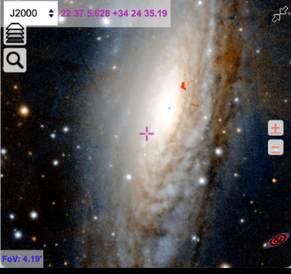
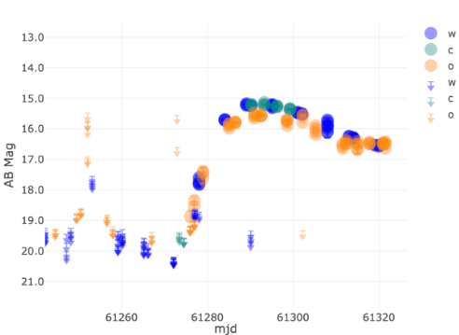
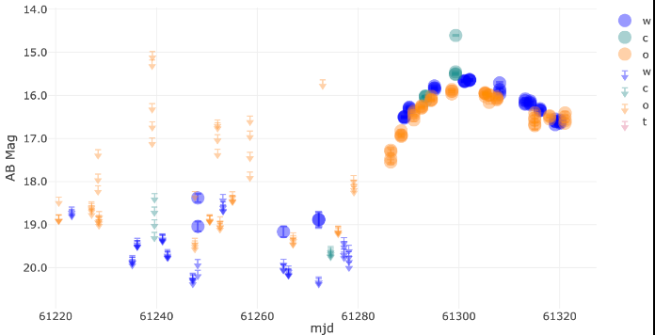
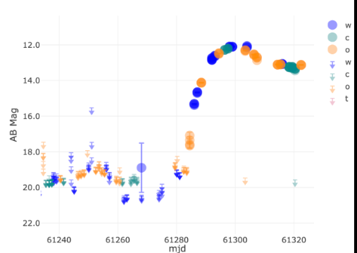
Our observations [1/2]: targets
SN2026zwp
SN2026aacj
SN2026aaiv

Slide 11
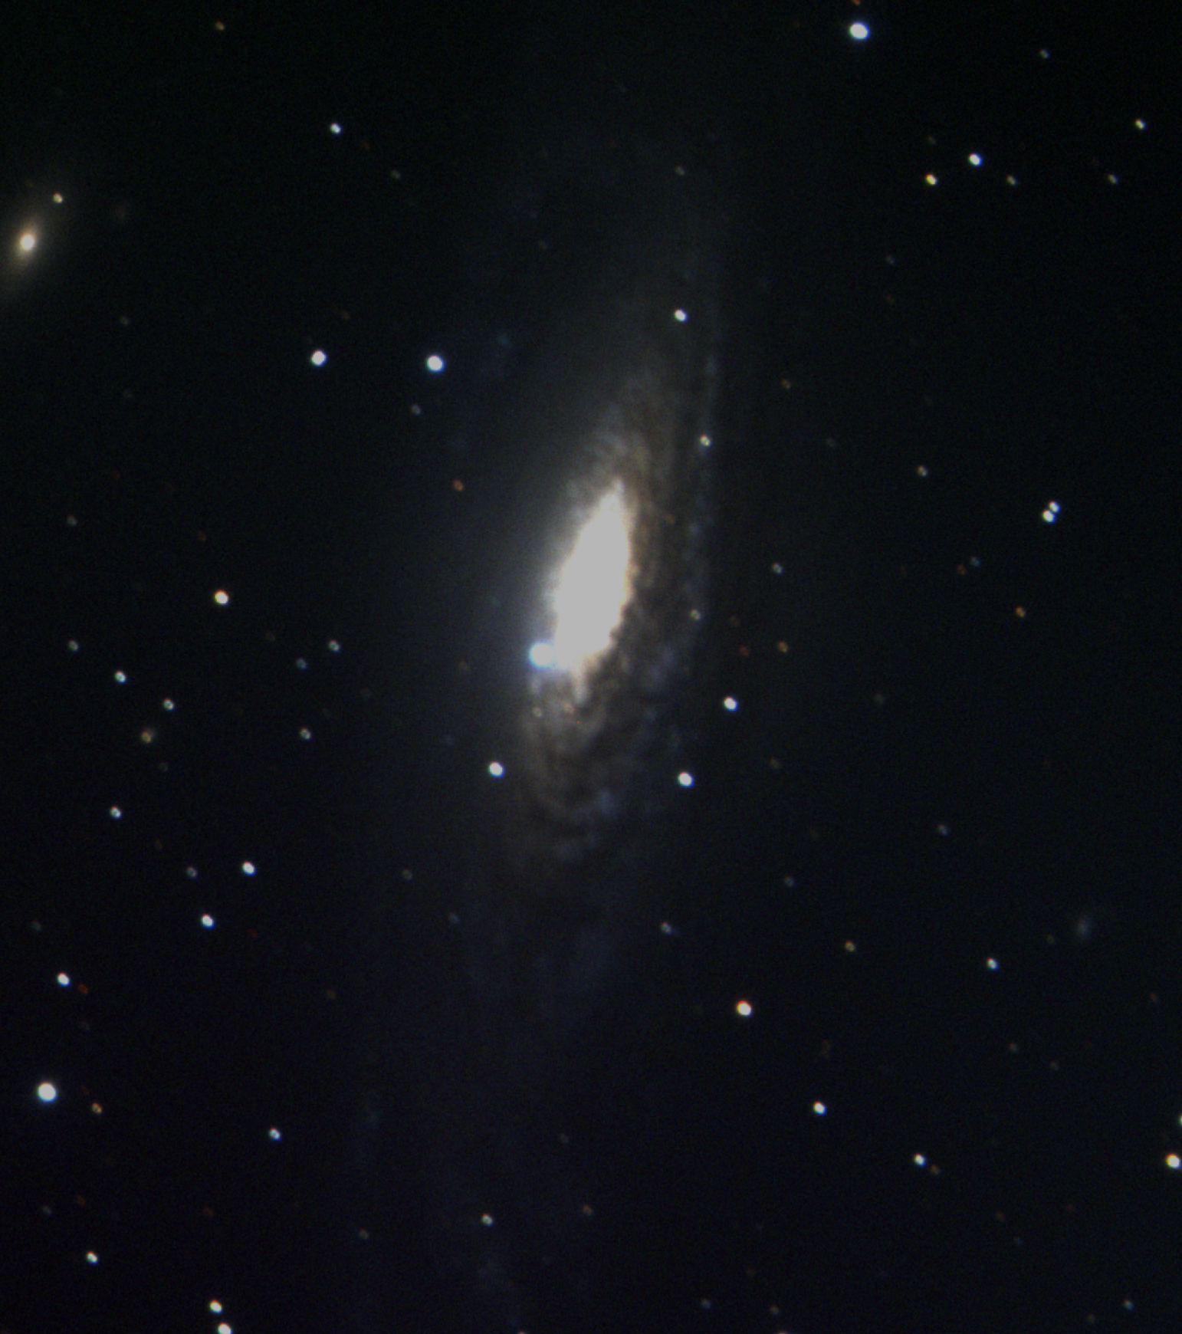
Our observations [2/2]: targets
SN2026aaiv
13/10/2026

Slide 12

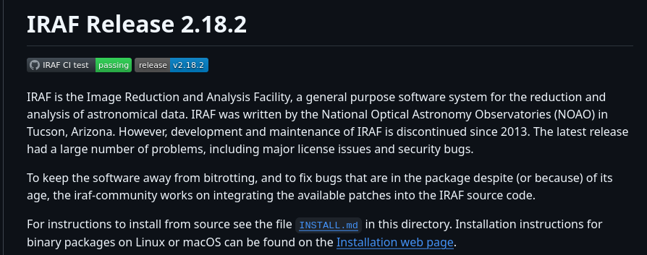
Data reduction with IRAF
IRAF — Image Reduction and Analysis Facility
• A collection of several hundred tasks grouped in packages: images (headers, statistics), ccdred (bias, flat), onedspec / twodspec (extraction, wavelength and flux calibration, spectral analysis)
• Every step is recorded in the FITS header (DOPCOR, DEREDDEN, …)
• PyRAF: the same tasks called from Python
Tasks used in this work: dopcor, deredden, splot (e–e, k–g), imheader
Further reading and installation: https://github.com/iraf-community/iraf (source code, binary packages for Linux and macOS, documentation and forum)

Slide 13
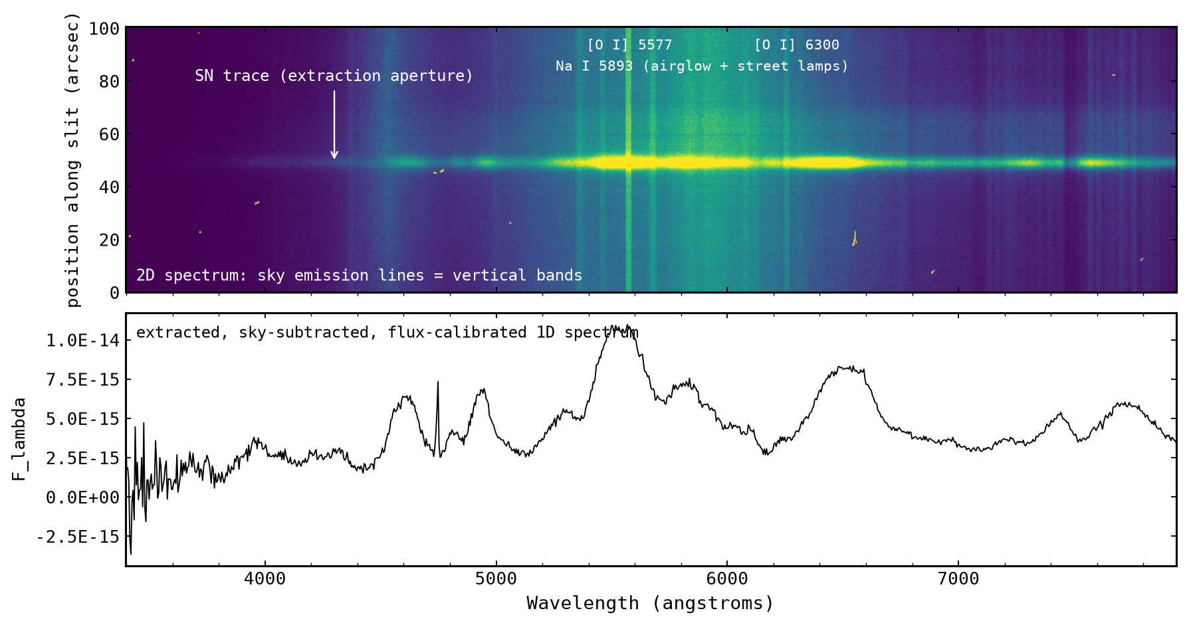
From the 2D frame to the 1D spectrum
Methods: raw spectra → deredden (Milky Way extinction) → Doppler correction → Na I D equivalent width → convolution for colour → A_{V}
What the pipeline did
• Bias, flat field, cosmic-ray cleaning
• Trace the SN and extract the spectrum in an aperture around it (IRAF apall); the sky is measured on both sides of the trace and subtracted
• Wavelength calibration with Ne and HgCd arc lamps; flux calibration with a spectrophotometric standard star; telluric correction
• Result: the 1D spectrum below, F_{λ} vs wavelength — our starting point ("raw spectrum")
SN 2026aaiv, 300 s, Asiago 1.82 m + AFOSC, grism 4, 2.5″ slit, 2026-10-13. Top: the 2D frame, wavelength axis from the sky lines. Bottom: the extracted spectrum.

Slide 14
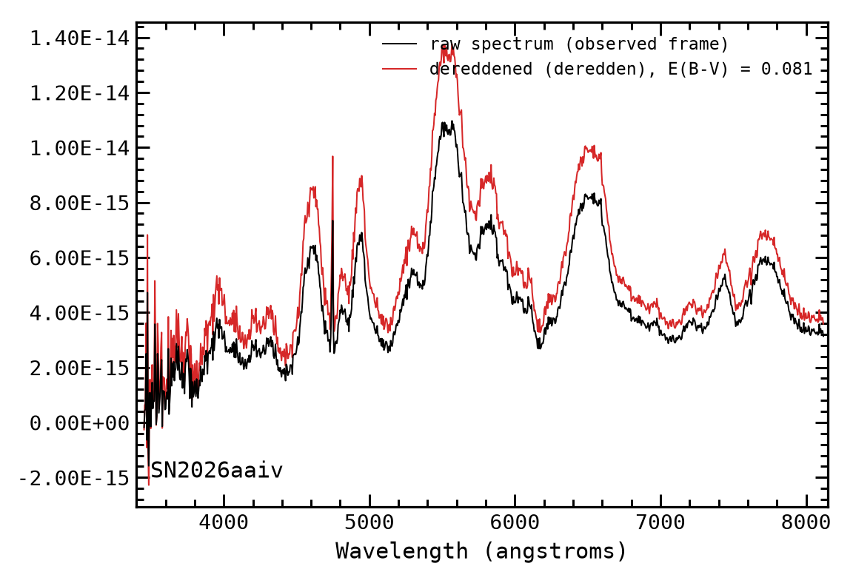
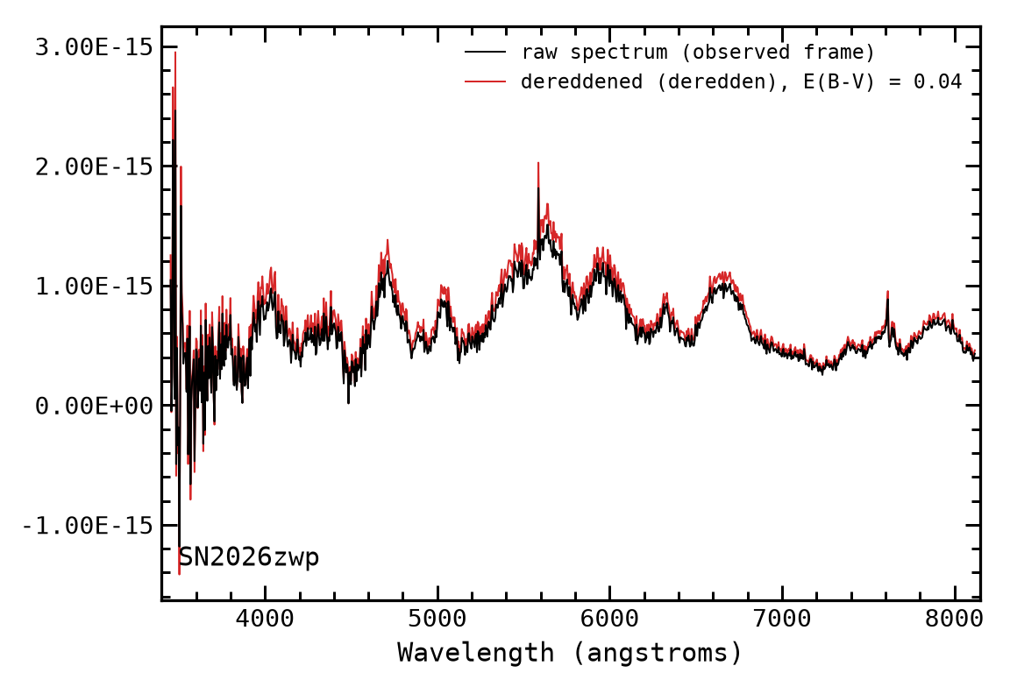
Data reduction: raw spectrum and Milky Way extinction
Methods: raw spectra → deredden (Milky Way extinction) → Doppler correction → Na I D equivalent width → convolution for colour → A_{V}
Galactic extinction
• E(B−V) from the NED extinction calculator (Schlafly & Finkbeiner 2011) at the SN position
• A_{V} = 3.1 × E(B−V)
• Red curve: the flux rises, more in the blue than in the red
Black: raw spectrum, Asiago 1.82 m + AFOSC, grism 4, 2026-10-13; wavelength- and flux-calibrated, telluric-corrected.
Dereddening is done first, in the observed frame, because the Milky Way dust is at z = 0. After this step the colour of the spectrum carries only the host reddening. Equivalent widths are not changed (line and continuum are scaled by the same factor).
2007 SNe (archival): E(B−V)_{MW} and E(B−V)_{host} from Burns et al. (2014); R_{V} = 3.1.
MW extinction in V (NED)
SN | E(B−V)_{MW} | A_{V, MW}
SN 2026aacj | 0.071 | 0.220
SN 2026zwp | 0.040 | 0.123
SN 2026aaiv | 0.081 | 0.250

Slide 15
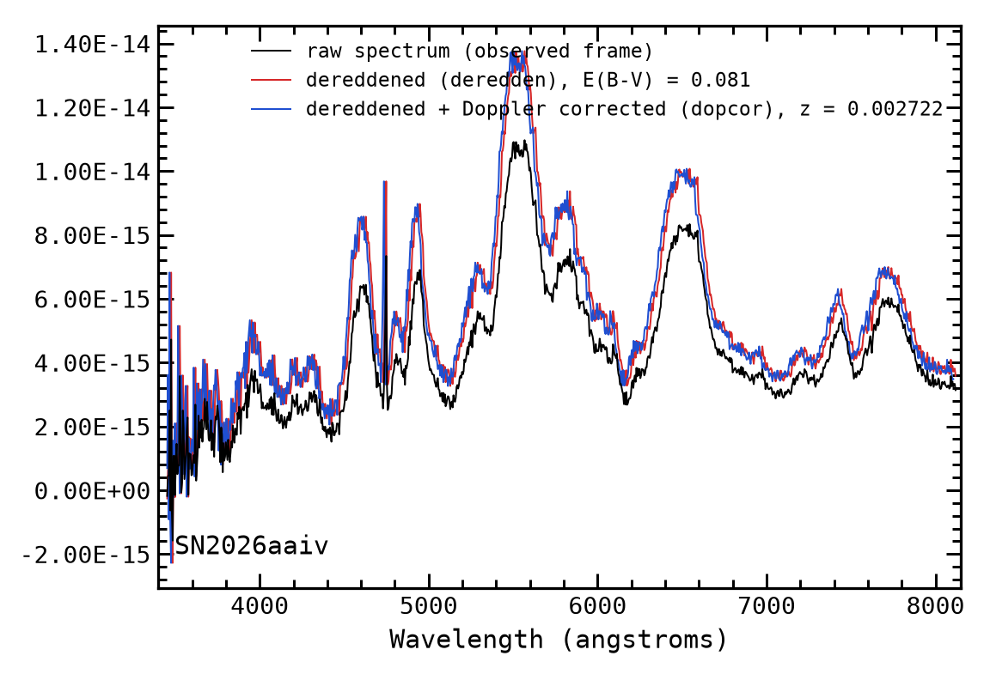
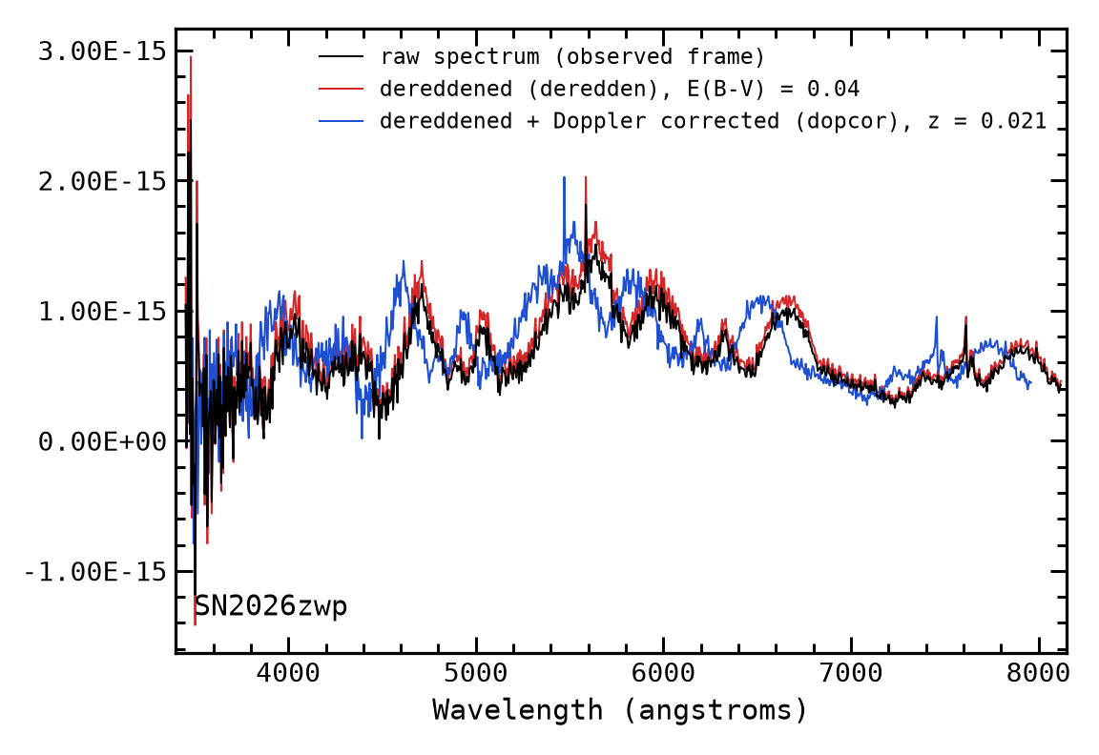
Doppler correction
Methods: raw spectra → deredden (Milky Way extinction) → Doppler correction → Na I D equivalent width → convolution for colour → A_{V}
IRAF dopcor (blue), applied to the dereddened spectrum: λ_{rest} = λ_{obs} / (1+z) with the host redshift (TNS/NED). Every feature moves to its rest wavelength; the flux is not changed.
In the rest frame the host Na I D is at 5890 Å; the Milky Way line (z = 0) ends up blueward of it, at 5890 / (1+z).

Slide 16
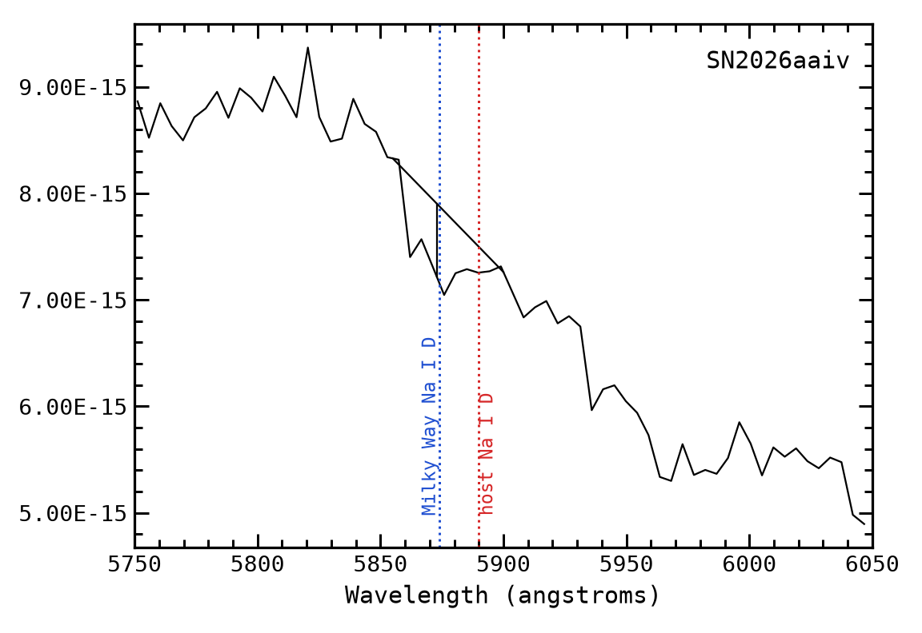
Equivalent width, colour and A_{V}
Methods: raw spectra → deredden (Milky Way extinction) → Doppler correction → Na I D equivalent width → convolution for colour → A_{V}
Na ID equivalent width
• IRAF splot on the corrected spectrum
• e–e: straight continuum between two cursor points (linear)
• k–k: Gaussian fit (Gaussian)
• Repeated with different continuum points: mean ± scatter; no line → upper limit
Colour by convolution → A_{V}
• Spectrum convolved with the B and V filter curves → B, V
• Intrinsic colour from the Lira relation at the phase of the spectrum
• E(B−V)_{host} = (B−V)_{dered} − (B−V)₀
Convolved photometry
SN | z | B | B_{dered} | V | V_{dered} | (B−V)_{dered}
SN 2026aaiv | 0.0027 | 15.67 | 15.34 | 14.42 | 14.16 | 1.180
SN 2026zwp | 0.021 | 17.54 | 17.36 | 16.52 | 16.35 | 1.010
SN 2026aacj | 0.02 | 17.82 | 17.51 | 16.93 | 16.69 | 0.820
SN 2026aaiv, Na ID region, splot e–e. Continuum between the two cursor points, tick at the measured centre. The absorption (EW 2.2 Å) is centred at 5873 Å, on the Milky Way Na I D (blue), not on the host line (red, 5890 Å): host EW < 0.7 Å (limit).
Lira relation → A_{V}
SN | t_{max} (MJD) | days since max | (B−V)₀ | E(B−V)_{host} | A_{V}
SN 2026aaiv | 61300.01 | 26 | 1.007 | 0.173 | 0.535
SN 2026zwp | 61292.58 | 34 | 0.931 | 0.079 | 0.243
SN 2026aacj | 61299.86 | 27 | 0.998 | −0.178 | −0.552 (→ 0)
Na I D EW (host), this sample: 2007af < 0.07 Å, 2007bm 2.9 ± 0.4 Å, 2007le 1.55 ± 0.06 Å, 2012bm 2.6 ± 0.1 Å, 2026aacj 0.9 ± 0.1 Å, 2026zwp 0.8 ± 0.05 Å, 2026aaiv < 0.7 Å (linear; Gaussian values agree).

Slide 17
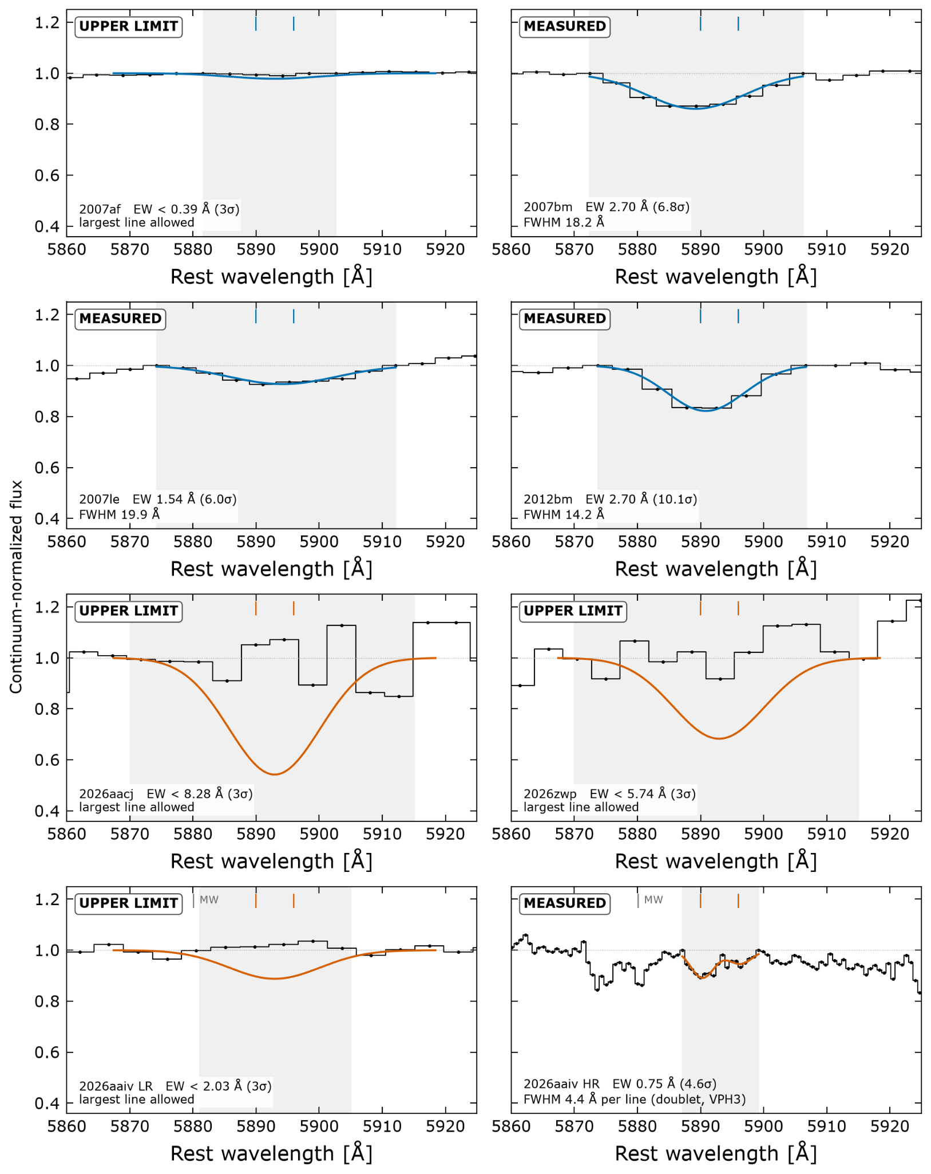
Results [1/3]: Equivalent Line Widths
Detected Na ID lines: 2007bm, 2007le, 2012bm, and 2026aaiv (high res)
Undetected Na ID lines: 2007af, 2026aacj, 2026zwp, 2026aaiv (low res)
Key:
Blue: archival observation
Orange: new observation

Slide 18
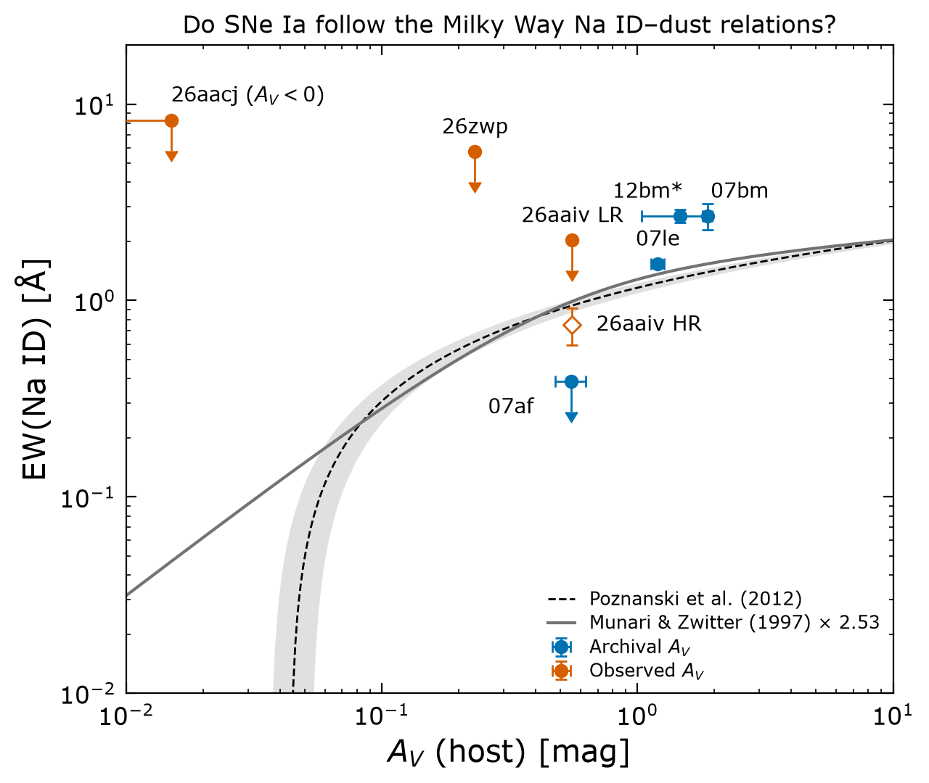
Results [2/3]: Comparing vs Empirical Relation (Milky Way)
Archival Data
  07bm, 07le, 12bm all are above the Poznanski+12 MW relations as found by Phillips+13
  07af sits below Poznanski+12 MW relations
Measured Data
  26aacj and 26zwp are upper limits so not actually constraints
  26aaiv:
    LR is only upper limit
    HR is consistent with Poznanski+12
Takeaway: Our results are consistent with Phillips+13 showing that SNeIa bias high in EW for a given A_{v}

Slide 19
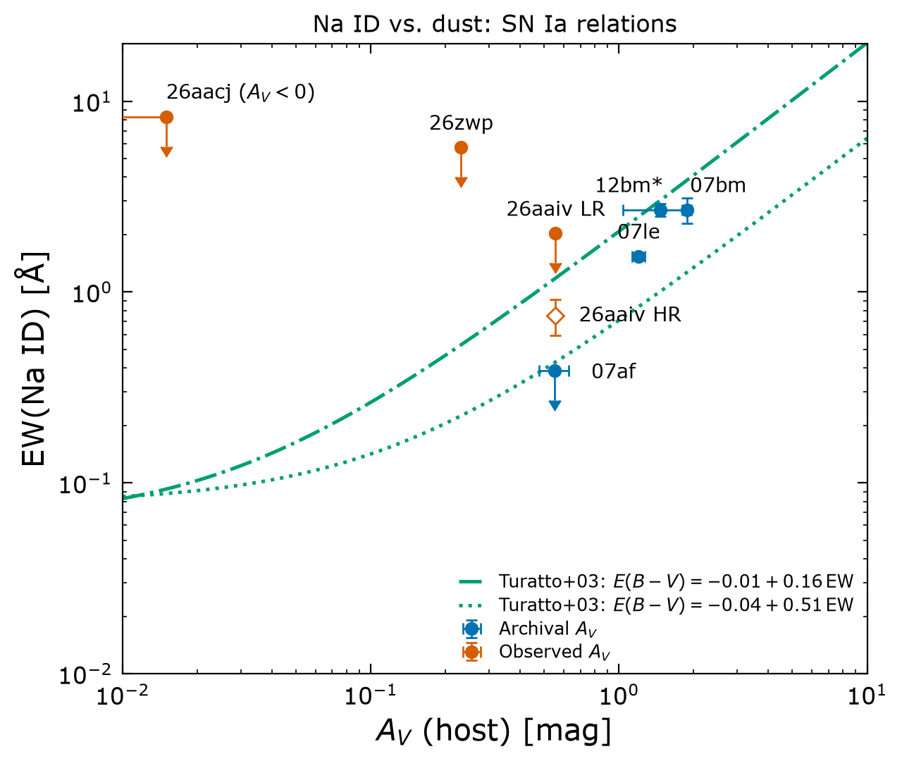
Results [3/3]: Comparing vs Empirical Relation (SNe Ia)
When we compare to SNe Ia empirical relation(s) from Turatto+03, our observations are consistent

Slide 20
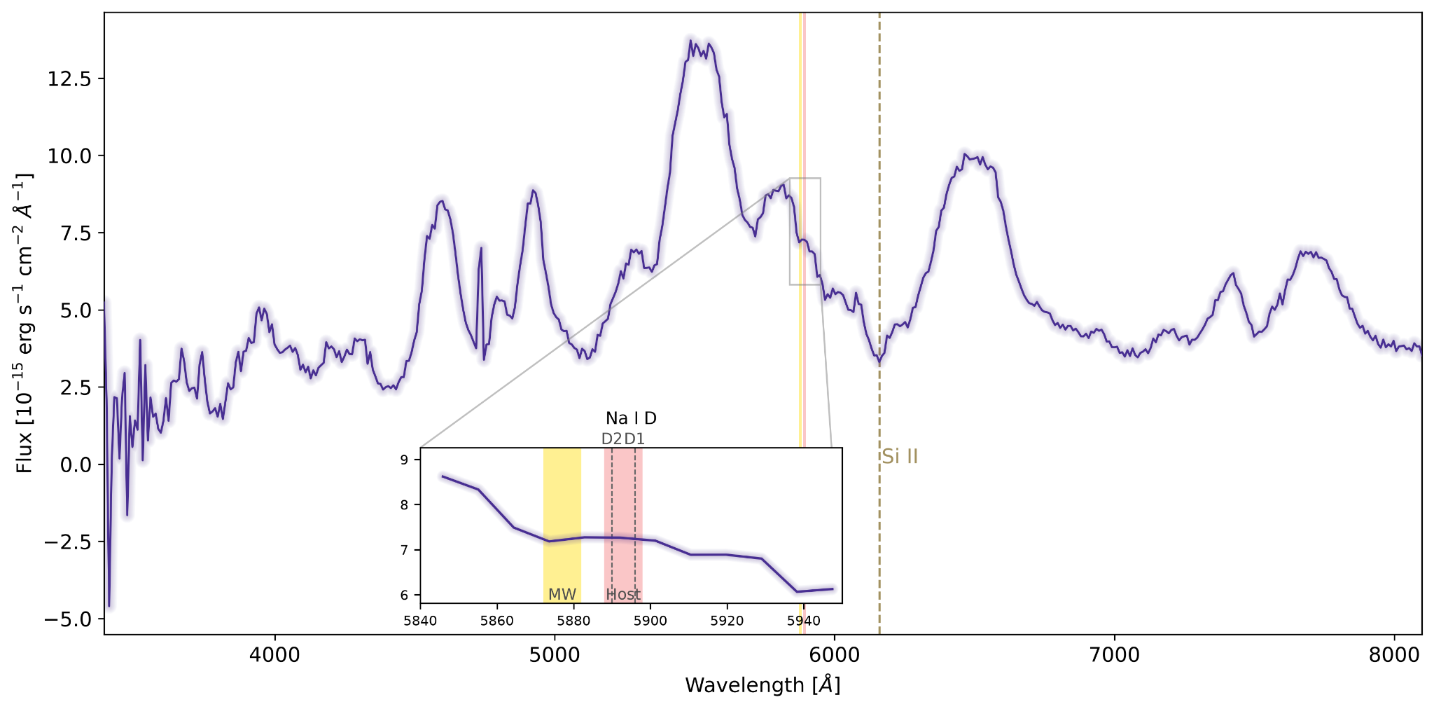

The SN2026aaiv case of study
We can’t see so absorption line feel free to group and make fun of us

Slide 21
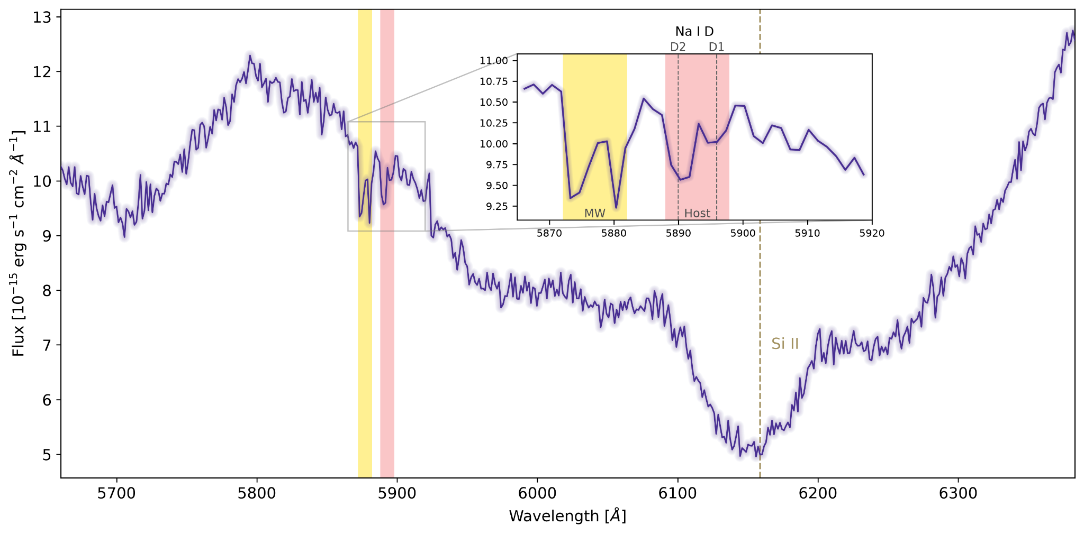

The SN2026aaiv case of study
We can’t see so absorption line feel free to group and make fun of us
We can see them so they go back quietly to their place

Slide 22
The SN2026aaiv case of study
We can’t see so absorption line feel free to group and make fun of us
No Phillips2013 blue shifting
We can see them, they go back quietly to their place

Slide 23
Low resolution limitation
Low resolution spectra make it hard to identify absorption lines when continuum is decreasing steeply

Slide 24
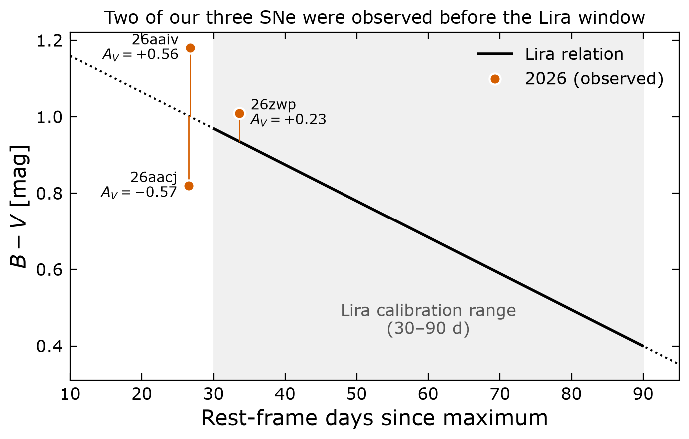
The SN2026aaiv case of study ( +SN2026aacj)
Fig: Folatelli+10
Lira relation is only calibrated from 30-90d since maximum but two of our observations are <30d since max
  We should repeat measurements in ~7 days to be comfortably inside the calibrated Lira region

Slide 25

Other Limitations
Very bad seeing
Degrading of resolution

Slide 26
Other Limitations
We use constant R_{V} which might be unreliable
  Burns+14 derives R_{V} from color instead of constant value → lower A_{V} → reduces discrepancy of SN2007af

Slide 27


